Slide 1
Lec.4
Organo Lithium and organo Sodium

Slide 2
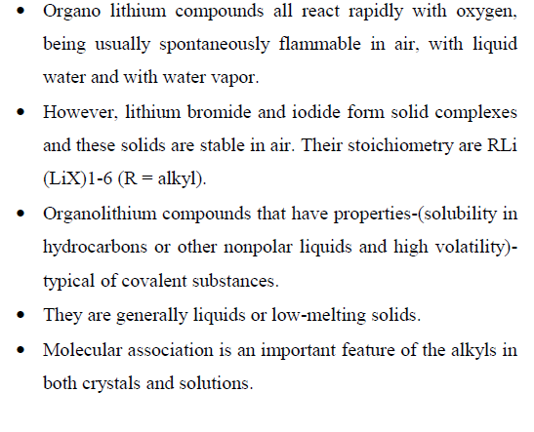

Slide 3
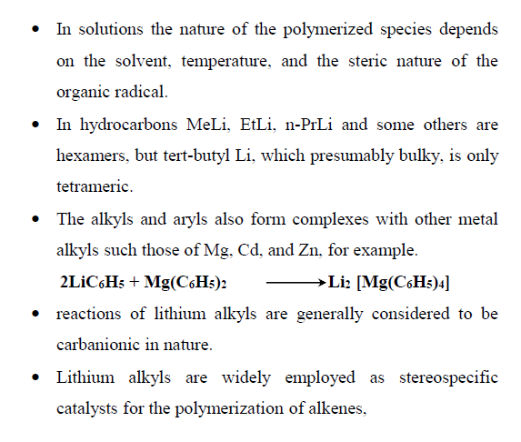

Slide 4
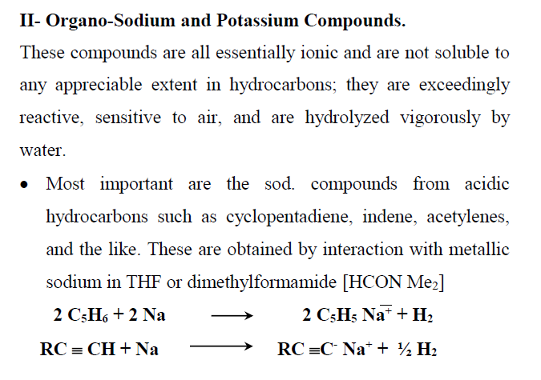

Slide 5
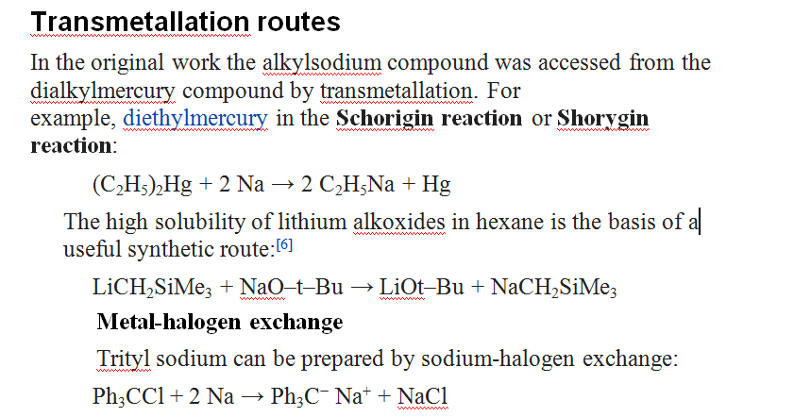

Slide 6
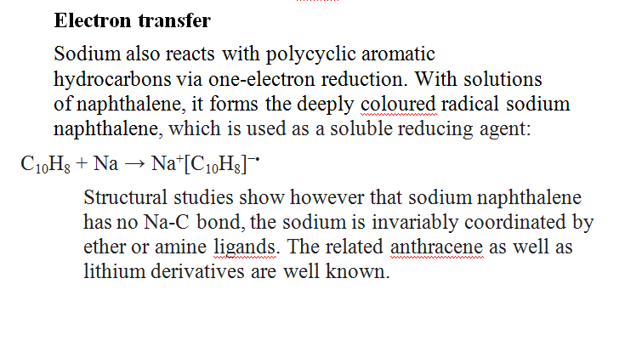

Slide 7
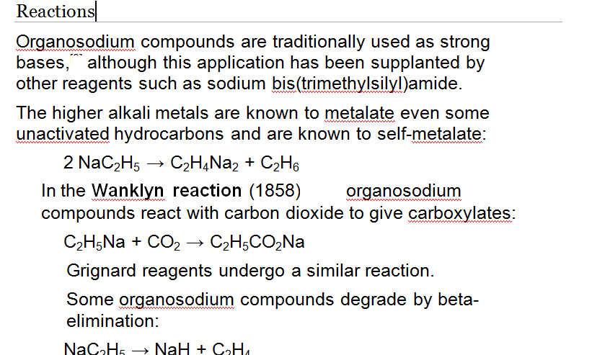

Slide 8
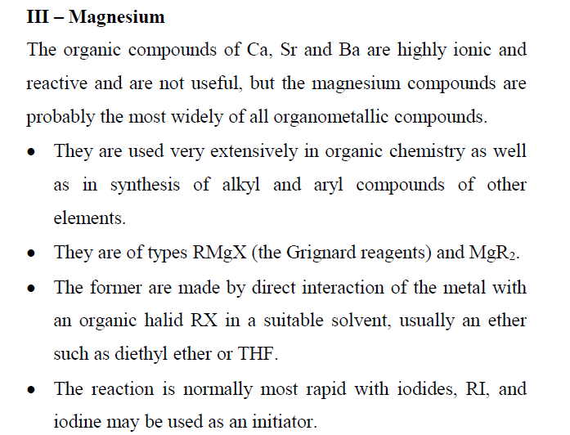

Slide 9
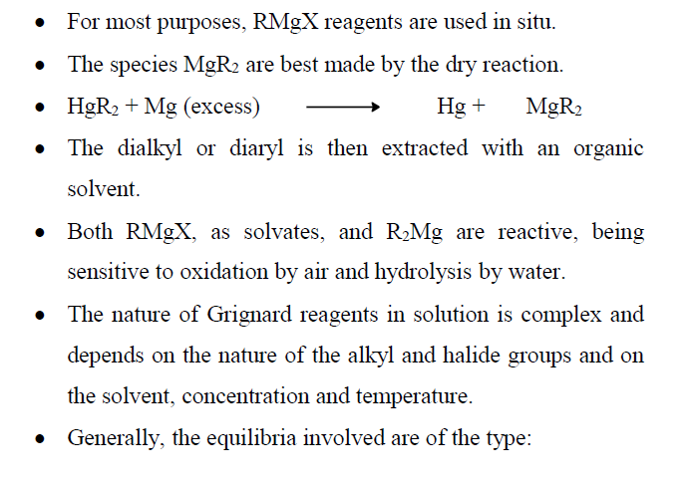

Slide 10
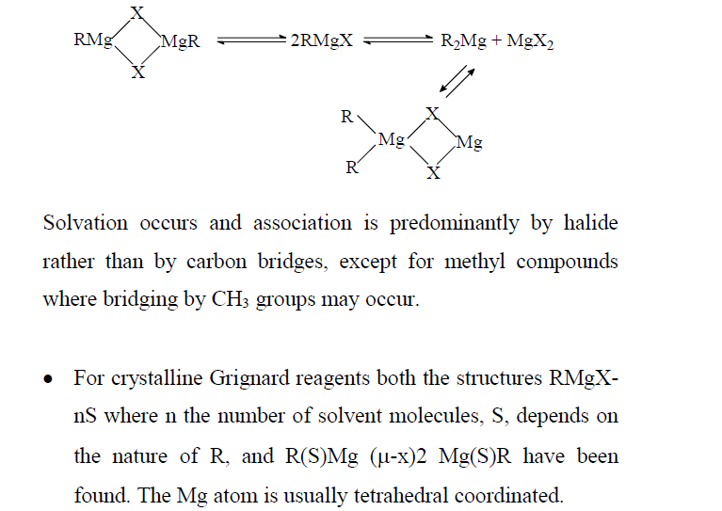

Slide 11
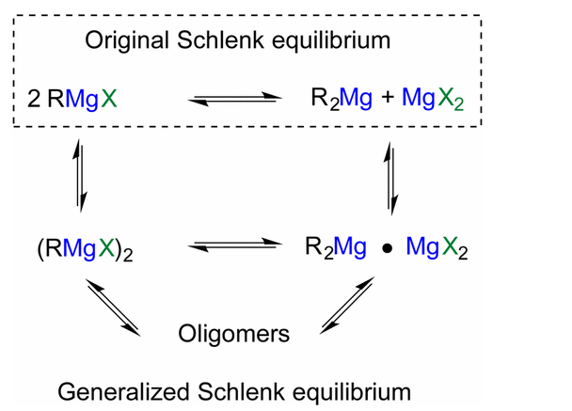

Slide 12
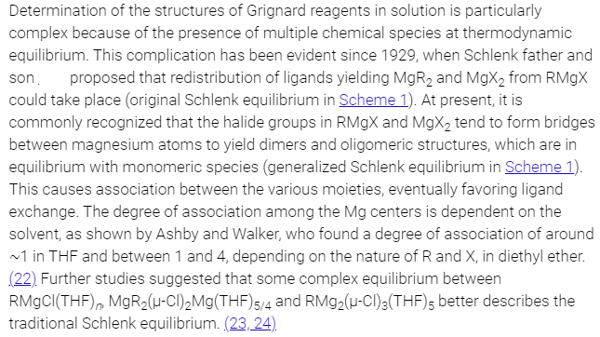

Slide 13
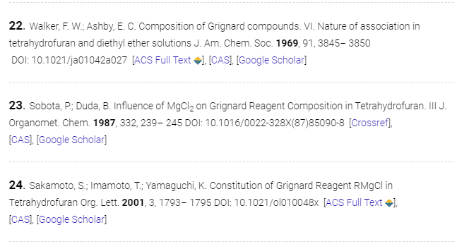

Slide 14
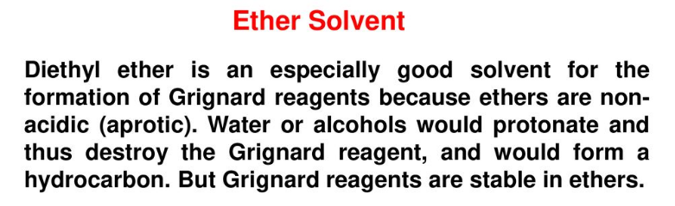
How Solvent Dynamics Controls the Schlenk Equilibrium of Grignard Reagents: A Computational Study of CH3MgCl in Tetrahydrofuran
Raphael M. Peltzer, Odile Eisenstein, Ainara Nova, and Michele Cascella
The Journal of Physical Chemistry B 2017 121 (16), 4226-4237
DOI: 10.1021/acs.jpcb.7b02716

Slide 15
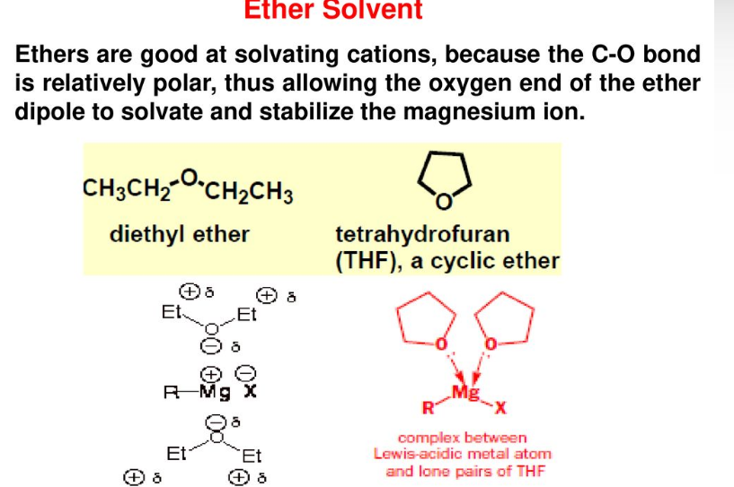

Slide 16
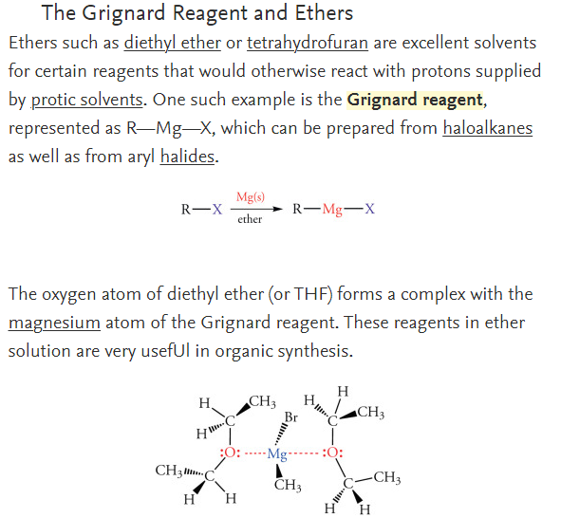

Slide 17
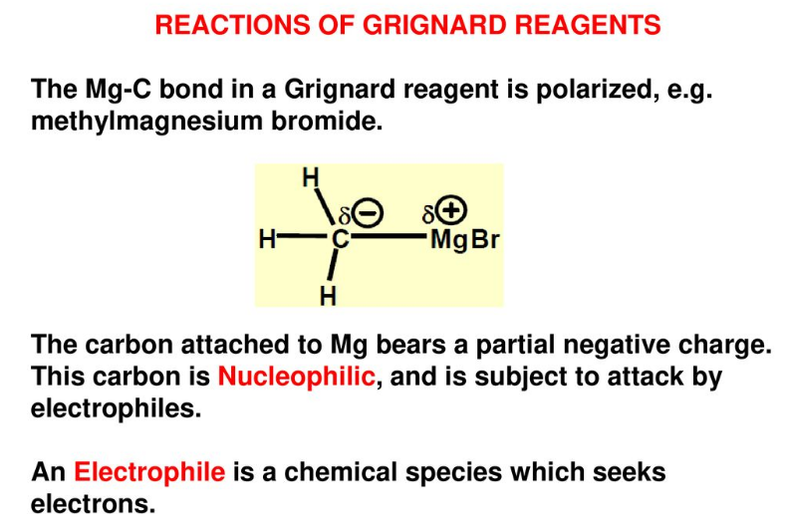

Slide 18
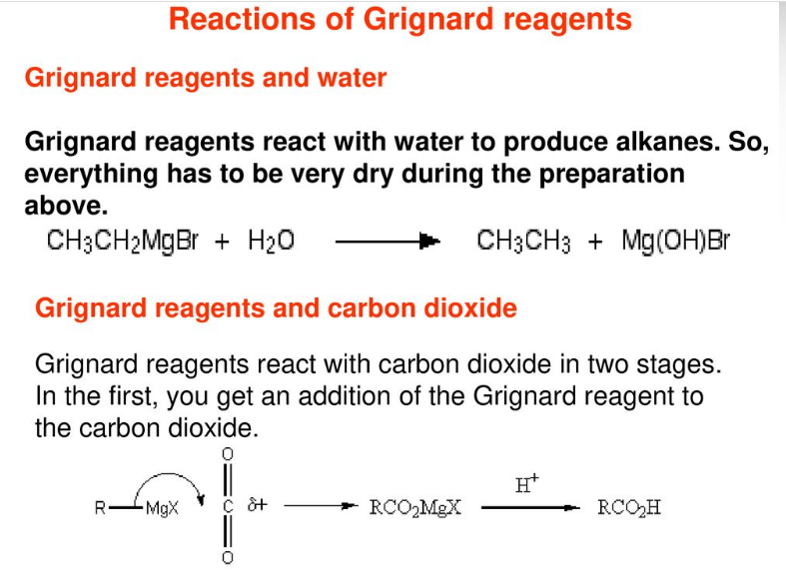

Slide 19
